Slide 1
Expanding Our Spiritual Vision: How to Become Magnified in Faith and Knowledge
Instagram: GospelGuardianLDS

Slide 2
Joel 2:28
“And it shall come to pass in the last days, saith God, I will pour out of my Spirit upon all flesh: and your sons and your daughters shall prophesy, and your young men shall see visions, and your old men shall dream dreams:”

Slide 3
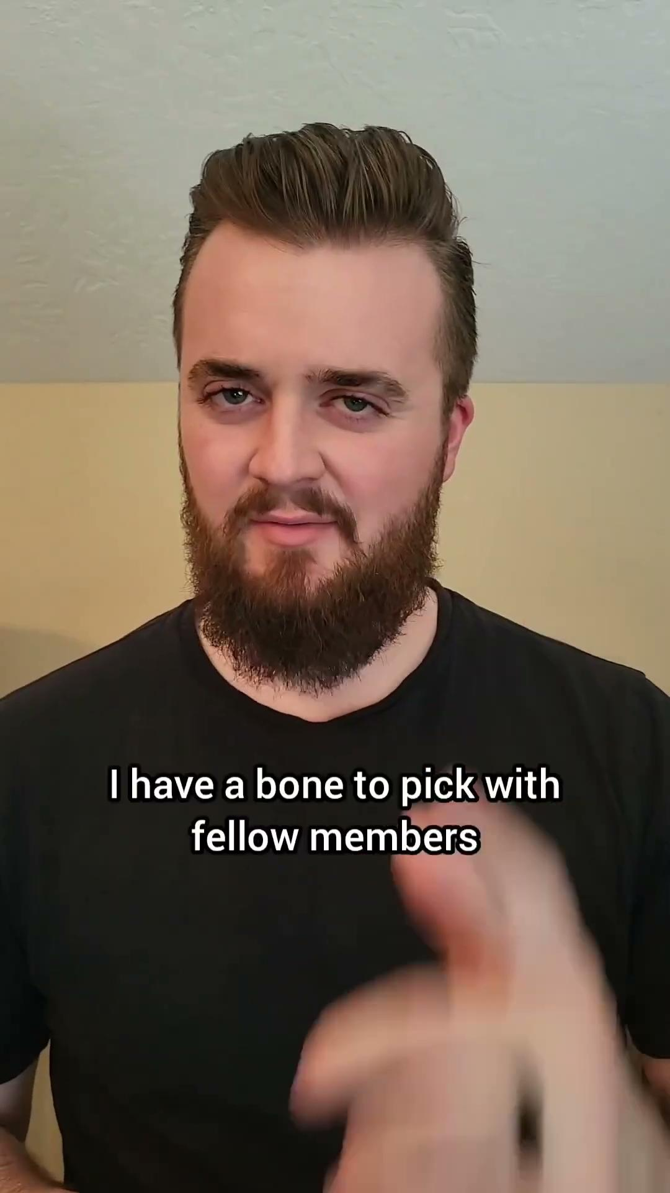

Slide 4
Miracles, Visions, Prophecies?
Jesus Christ
  Healing of the sick
  Raising from the dead
  Water to wine
  Feeding the multitudes
Apostles and Disciples
  John and Revelation
  Mount of transfiguration
  Vision of Stephen
  Angelic visitations in the Book of Mormon
Joseph Smith
  Angelic visitations
  Over 100 recorded revelations
  Many prophecies
Early Saints
  Heavenly beings on Kirtland temple roof
  Kirtland Day of Pentecost
  Miraculous healings
  Protection from enemies (Zion’s Camp)
  Wilford Woodruff founding fathers vision
  Joseph F. Smith D&C 138 vision
  Lorenzo Snow’s vision of Christ
  President Nelson getting revelation at night
What about us?

Slide 5
What about us?
Do you want to experience miracles? Do you want to have visions? Do you want the mysteries of God to be revealed to you?

Slide 6
James 1:5
-7
“If any of you lack wisdom, let him ask of God, that giveth to all men liberally, and upbraideth not; and it shall be given him.”
“But let him ask in faith, nothing wavering. For he that wavereth is like a wave of the sea driven with the wind and tossed.
For let not that man think that he shall receive any thing of the Lord.”

Slide 7
Examples?
Three Types of Lack of Faith
Faithless: Laman and Lemuel
Effort Without Understanding: Mark 9:17-29
Father and child with demon
Understanding Without Effort: Matthew 14:28-31
Peter walking on water
What does it look like to not have sufficient faith?

Slide 8
Examples?
To Act and Be Acted Upon:
Mark 5:25-34
Woman with issue of blood
1 Nephi 16:18-32
Liahona and Nephi hunting
Rend the Veil:
Helaman 10:4-10
Nephi and the sealing power
Ether 3:6-15, 19
Brother of Jared and the Lord
What does it look like to have sufficient faith?

Slide 9
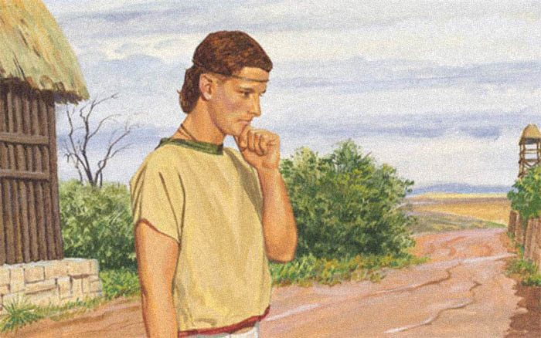
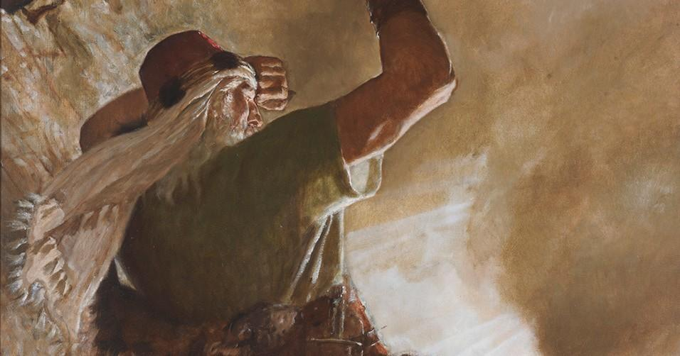
What can we learn from these examples?
Helaman 10:4-10
Ether 3:6-15, 19
Nephi was consistent in being obedient and dedicated to God (v.4)
God knew Nephi wouldn’t act contrary to His will (v.5)
God promised to do whatever Nephi spoke (v.7-10)
Mahonri saw what he saw because of faith (v.9)
You can request and receive more mysteries of God if you have sufficient faith (v.10,13,15)
The veil can be rent from sufficient faith (v. 19)

Slide 10
How do we get there?
Do you want to get there?
“...wherefore, dispute not because ye see not, for ye receive no witness until after the trial of your faith” - Ether 12:6

Slide 11
Let’s lay the foundation
Go back to Mark 9 - Father with son with demon
  v. 18-19 - Disciples couldn’t cast it out, Christ introduces urgency and a lesson
  v. 23-24 - Christ tells the father he just needs to believe (act or be acted upon)
Notes:
Mark 9
18-19: Who was Christ talking to as he said that? Maybe the father, but I’m thinking more the disciples
28-29: “Parable”? Saying it is going to take more daily and consistent work to get there

Slide 12
Examples?
To Act and Be Acted Upon:
Mark 5:25-34
Woman with issue of blood
1 Nephi 16:18-32
Liahona and Nephi hunting
Rend the Veil:
Helaman 10:4-10
Nephi and the sealing power
Ether 3:6-15
Brother of Jared and the Lord
What does it look like to have sufficient faith?

Slide 13
Let’s lay the foundation
Go back to Mark 9 - Father with son with demon
  v. 18-19 - Disciples couldn’t cast it out, Christ introduces urgency and a lesson
  v. 23-24 - Christ tells the father he just needs to believe (act or be acted upon)
  v. 28-29 - “...much prayer and fasting” but- Jesus didn’t pray and fast in that moment?
  The disciples didn’t have faith to act, so we are not at the point of rending the veil
Milestone 1: Getting to the point of acting or being acted upon
  “Wherefore, whoso believeth in God might with surety hope for a better world, yea, even a place at the right hand of God, which hope cometh of faith, maketh an anchor to the souls of men, which would make them sure and steadfast, always abounding in good works, being led to glorify God”. - Ether 12:4
  Go back to Mark 5:25-34 - Woman with issue of blood
  What did the woman first have when she heard Christ was coming?
  Then what did she do once her hope was full?
Notes:
Mark 9
18-19: Who was Christ talking to as he said that? Maybe the father, but I’m thinking more the disciples
28-29: “Parable”? Saying it is going to take more daily and consistent work to get there
Once you have hope, act, and receive a witness, remember that and treat it like the miracle it is! Use that miracle as a brick in your foundation. Once you have a firm enough foundation, you can progress to the next level. Even Peter on the water didn’t have enough of a firm foundation, he had bricks enough to ask to come on the water, and even to walk for a few steps, but once he saw the winds and water, the foundation crumbled and he fell (literally and figuratively).

Slide 14
How do I know when my foundation is strong enough?

Slide 15

“And now, behold, because ye have tried the experiment, [trial of your faith] and planted the seed, and it swelleth and sprouteth, and beginneth to grow, ye must needs know that the seed is good.
And now, behold, is your knowledge perfect? Yea, your knowledge is perfect in that thing, and your faith is dormant; and this because you know, for ye know that the word hath swelled your souls, and ye also know that it hath sprouted up, that your understanding doth begin to be enlightened, and your mind doth begin to expand.”
Alma 32:33-34

Slide 16
Then what?
What did Mahonri do after seeing the finger of the Lord?
  “Lord, show thyself unto me.”
  He asked for more.
So what should you do?
  Assess where you are, and ask for more.
  Line upon line, precept upon precept, here a little and there a little.
How do I obtain greater things?

Slide 17
Other things to consider
Notes:
Speak of your personal experiences and the need to have an entire day of spirituality. Much prayer and fasting.

Slide 18
Word of warning
What comes after you receive these witnesses?
Notes:
Greater spiritual responsibility and next slide

Slide 19

“...and now behold, after ye have tasted this light is your knowledge perfect?
Behold I say unto you, Nay; neither must ye lay aside your faith, for ye have only exercised your faith to plant the seed that ye might try the experiment to know if the seed was good.
And behold, as the tree beginneth to grow, ye will say: Let us nourish it with great care, that it may get root, that it may grow up, and bring forth fruit unto us. And now behold, if ye nourish it with much care it will get root, and grow up, and bring forth fruit.
But if ye neglect the tree, and take no thought for its nourishment, behold it will not get any root; and when the heat of the sun cometh and scorcheth it, because it hath no root it withers away, and ye pluck it up and cast it out.
Now, this is not because the seed was not good, neither is it because the fruit thereof would not be desirable; but it is because your ground is barren, and ye will not nourish the tree, therefore ye cannot have the fruit thereof.”
Alma 32:35-39

Slide 20
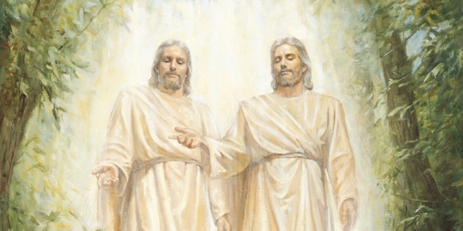
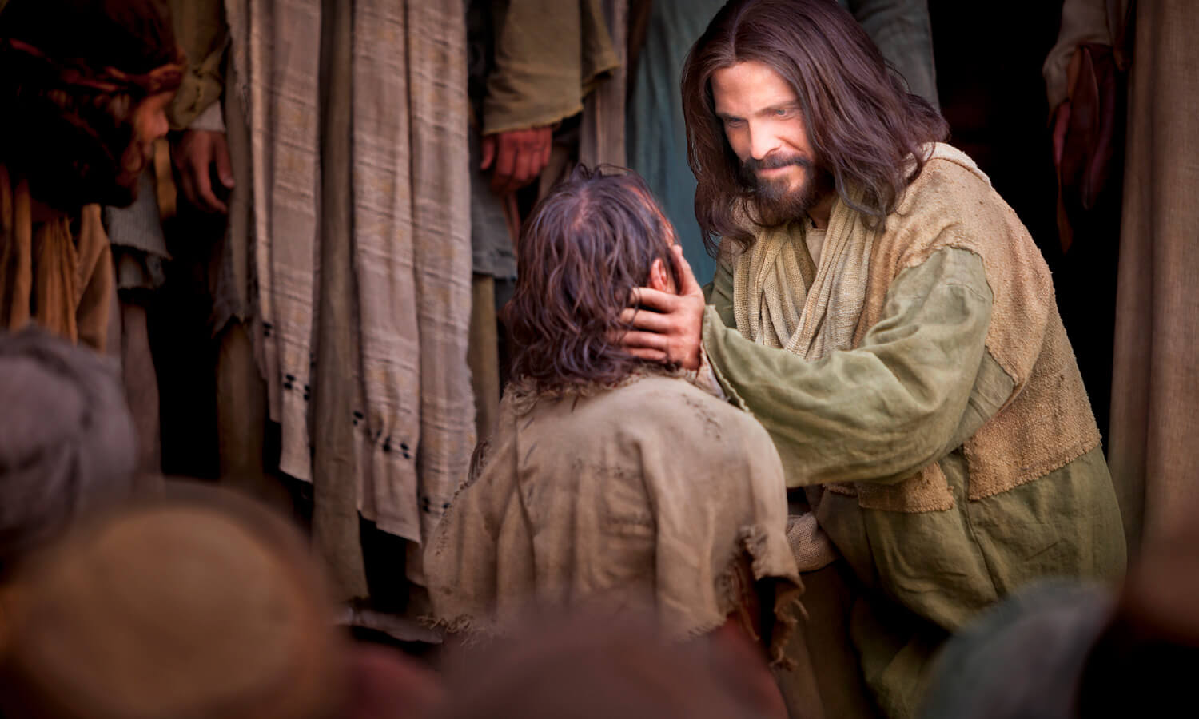
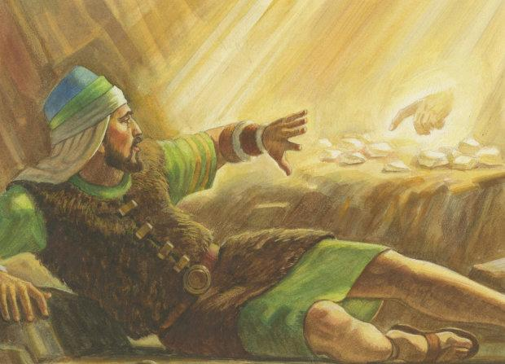
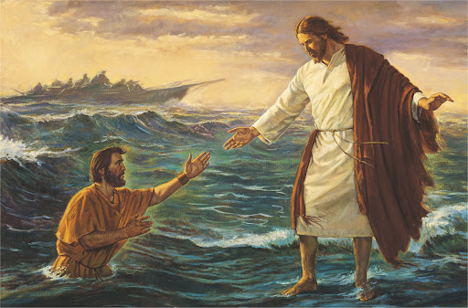
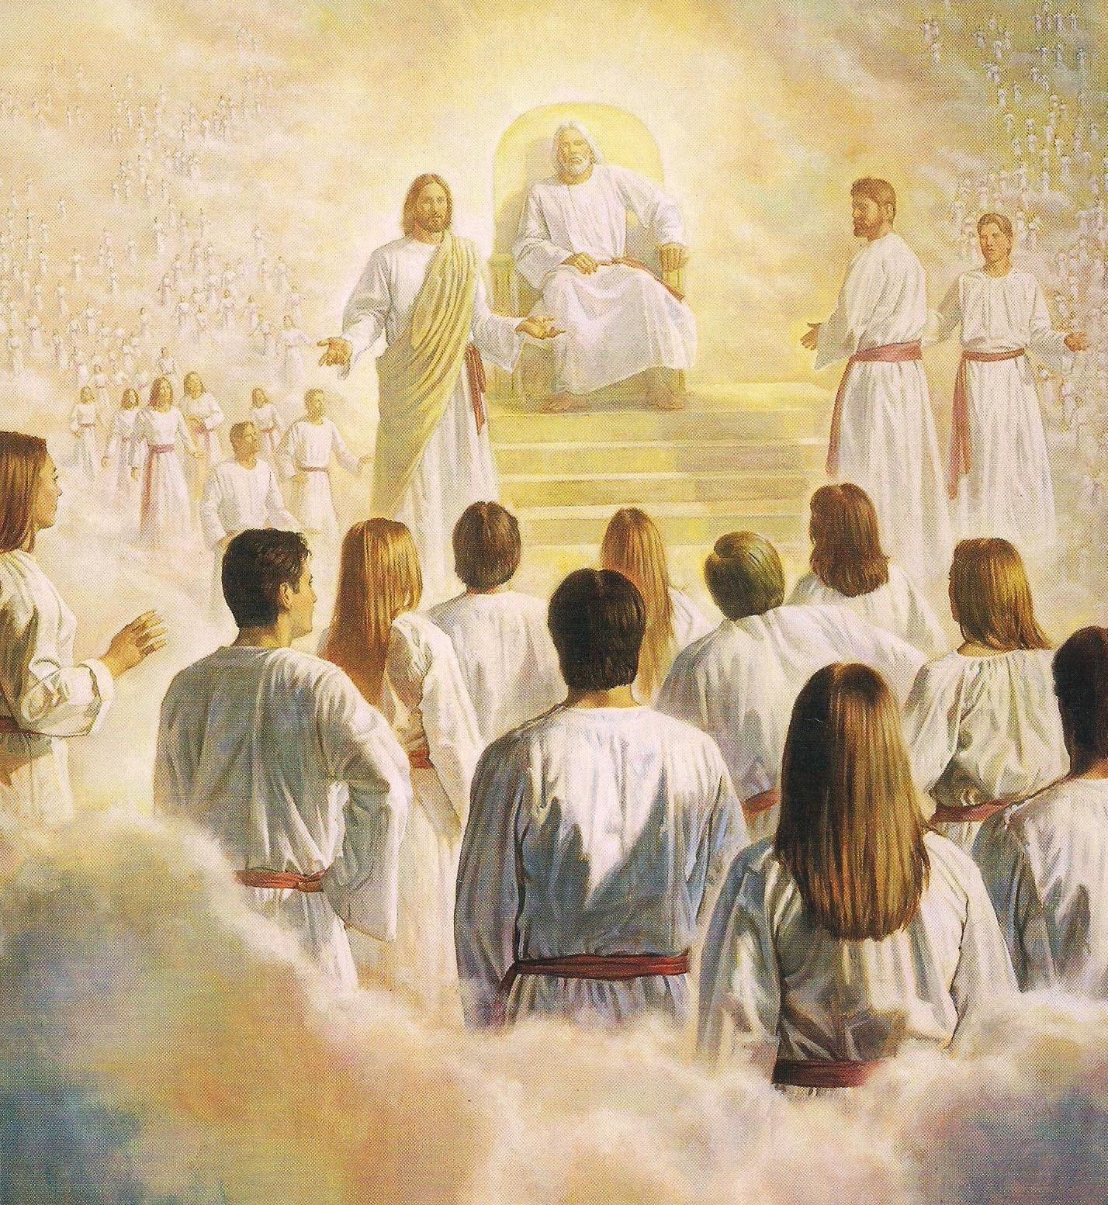
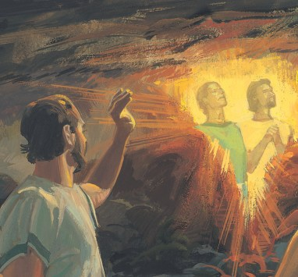
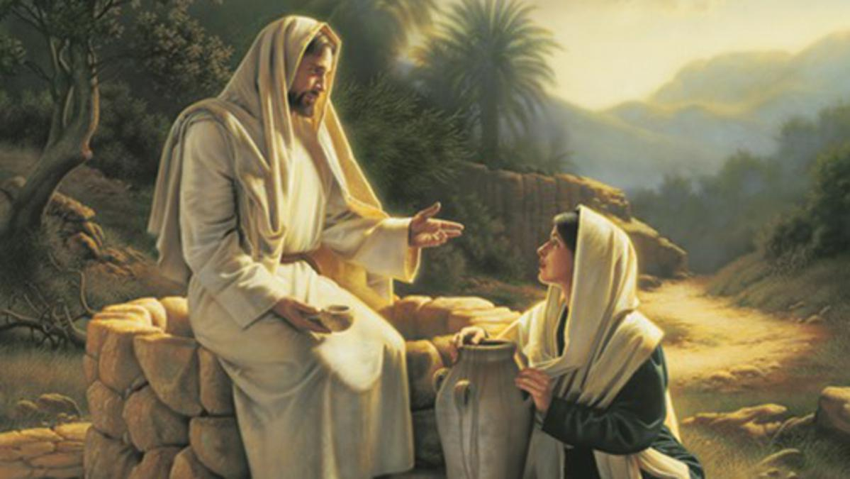

Slide 21
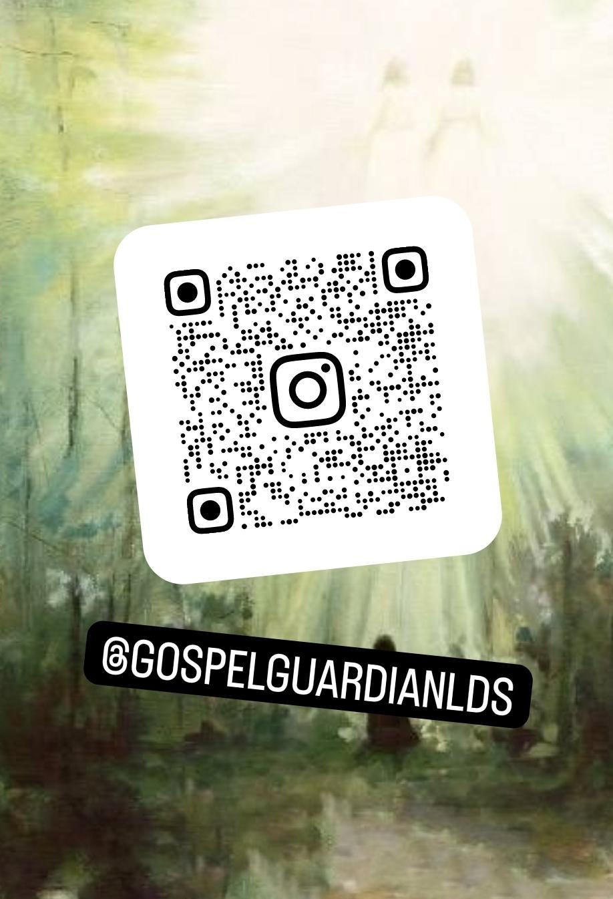


Slide 22
Resources
Scriptures
Lectures on Faith
Personal Revelation
Heavenly Father, Jesus Christ, and the Holy Spirit

